Slide 1


Rajshahi University of Engineering & Technology
Heaven’s Light is Our Guide
Presented by: MD Shohanur Rahman Roll: 123055 | Supervised by: Sadia Zaman Mishu Assistant Professor Dept. of CSE, RUET.

Slide 2
Outlines
Hyperspectral Image
AV3C Hyperspectral Data
Challenges with hyperspectral data
Motivation Objectives
Proposed Method
Principal Component Analysis
Mutual Information
Conclusion
Future work
References
2

Slide 3
Hyperspectral Image
Hyperspectral image:
  Sampled contiguously in the spectral range 400nm-2400nm
  Contains large data volume
  Provides details information about spectral classes
3

Slide 4
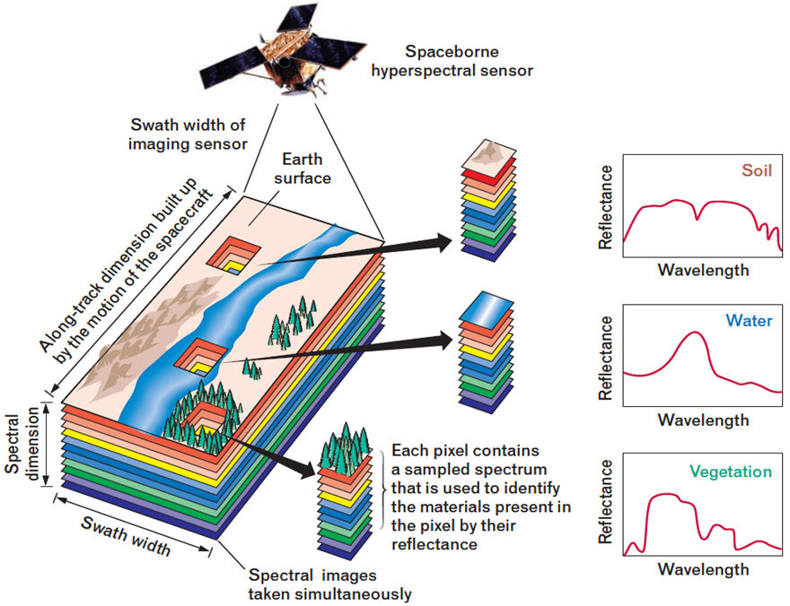
Hyperspectral Image Contd..
Fig 1: Hyperspectral image description [1]
4

Slide 5
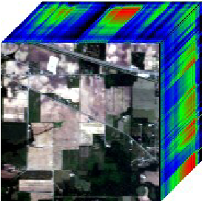
AV3C Hyperspectral Data
AVIRIS 92AV3C image:
  Contains 220 image bands
  Each band 145×145 pixels
  Has Spectral range: 400 to 2400 nm, covering visible to infrared region
  Has 16 classes
  Captured by AVIRIS sensor
Fig 2 : Hyperspectral image[5]
5

Slide 6
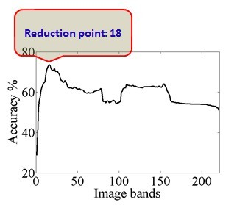
Challenges with hyperspectral data
Hyperspectral image:
  Has many Redundant information
  High Computational complexity
  Presents Curse of Dimensionality[4]
Fig 3 : performance vs. Dimension
6

Slide 7
Motivation and Objectives
Extract only relevant feature
Eliminate the curse of dimensionality issue
Improve classification accuracy through feature reduction
Select most informative features
7

Slide 8
Proposed Method
Collaboration of feature mining and classification
Feature Extraction:
Principal Component Analysis(PCA).
Feature Selection:
Mutual Information(MI).
Classification:
Support Vector Machine(SVM)
8

Slide 9
Feature Extraction
Feature means unique measurable characteristics of an image/observed object.
Feature extraction means creating new features which have the essence of
original features.
Feature extraction helps to obtain relevant information from large dataset.
8

Slide 10
Principal Component Analysis
Steps of Principal Component Analysis:
  Input the image
  Subtract the mean
  Calculate the covariance matrix
  Calculate the eigenvectors and eigenvalues of the covariance matrix
  Choose components and forming a feature vector
  FeatureVector = (eig1 eig2 eig3…eigN)
  Derive the new data set:
  FinalData = RowFeatureVector x RowDataAdjust
9

Slide 11
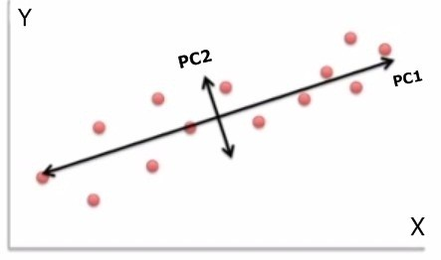
Principal Component Analysis Contd..
Only relevant features are obtained
Dimensionality reduced
Transformed data into orthogonal uncorrelated variables
Fig 4 : Principal Components
10

Slide 12
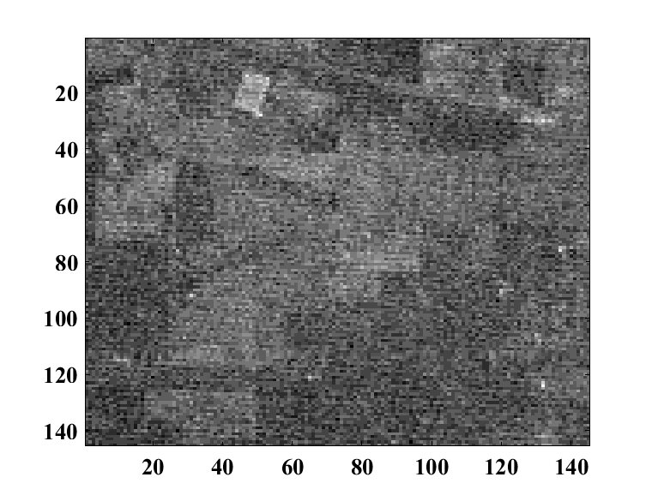
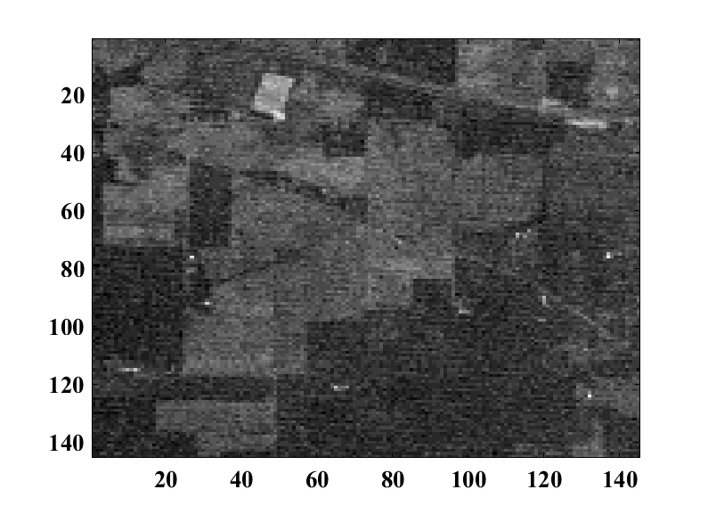
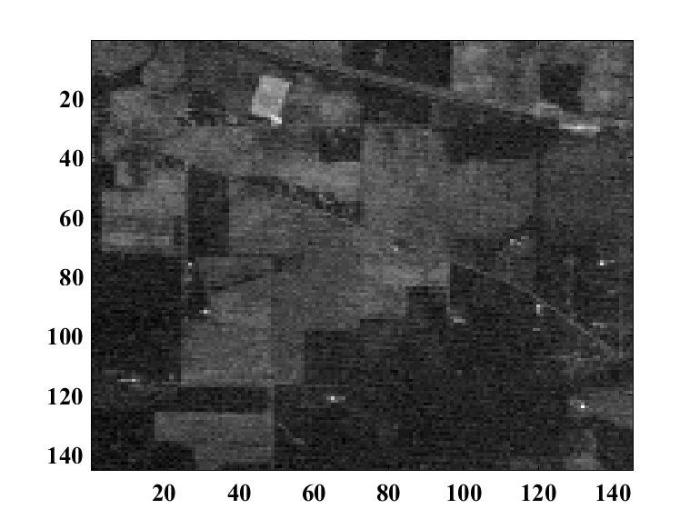
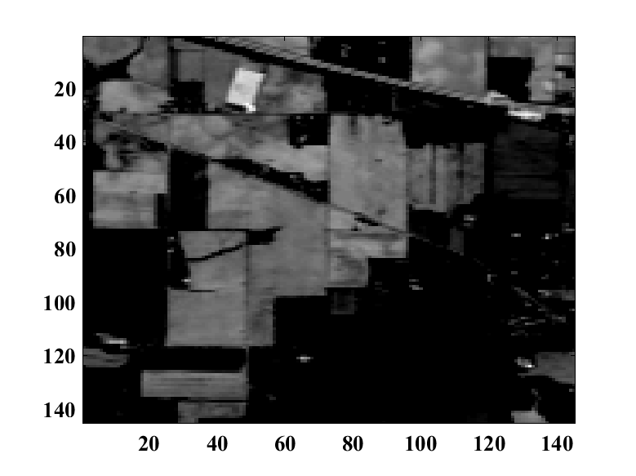
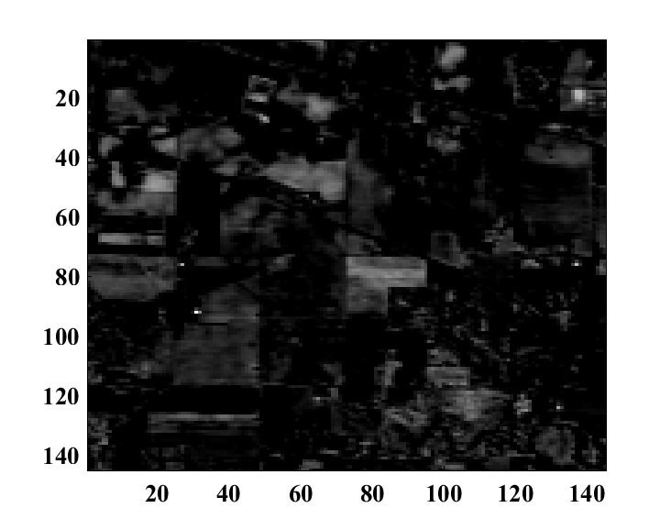
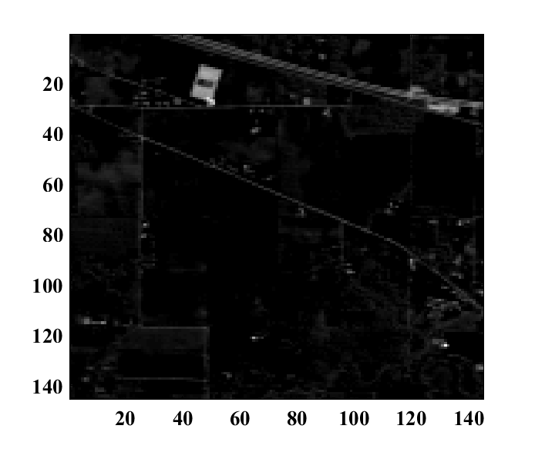
Original Image Band & PCA Band
Band 1 Band 2 Band 3
PC 1 PC 2 PC 3
11

Slide 13
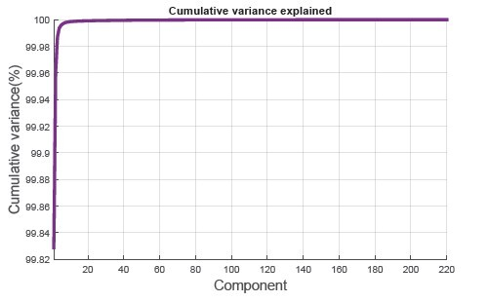
Result of Principal Component Analysis
After principal component analysis first 14 band (component) has 99.80% variance of the dataset.
Fig 5 : Cumulative Variance
12

Slide 14
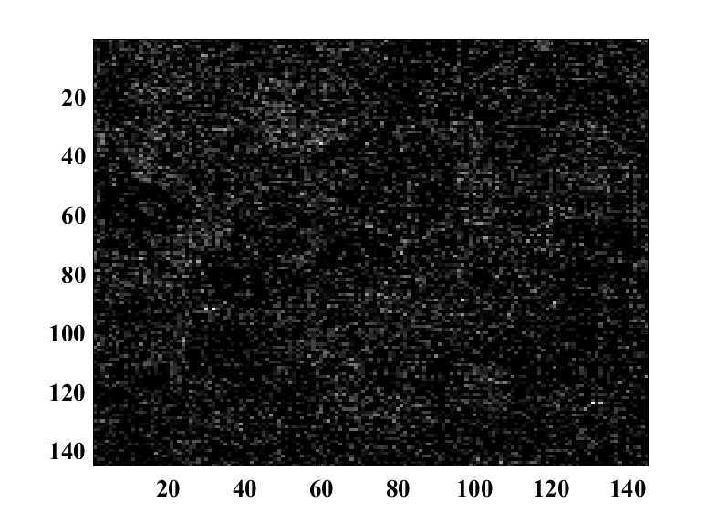
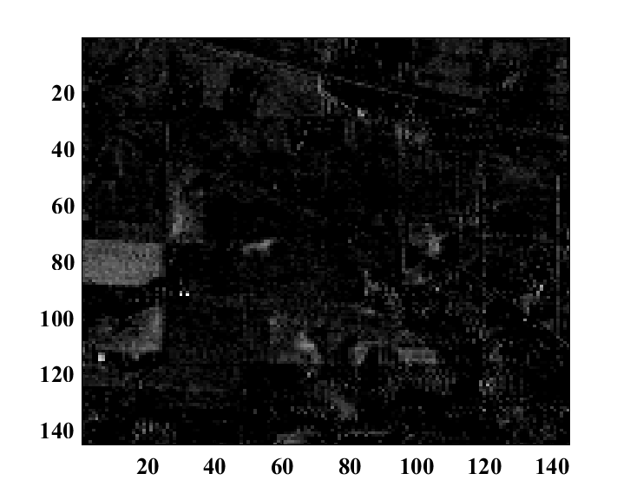
Limitations Principal Component Analysis(PCA)
PCA assumes that data is normal distributed and high variance data contains more information.
Here though PC 8 has high variance but it contains less information of image contents.
On the other hand PC 9 has low variance but it contains more information of image contents.
PC 8
PC 9
12

Slide 15
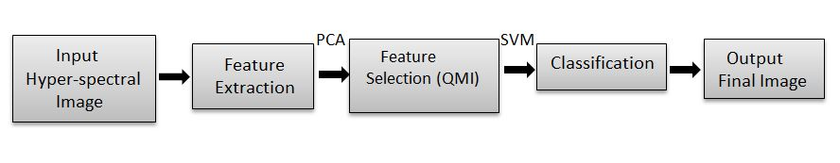
Feature Selection
To create an accurate predictive model
To identify and remove unneeded , irrelevant and redundant attributes
To overcome the limitations of PCA
Fig-6: Flow diagram of hyper-spectral image[2]
19

Slide 16
Mutual Information
Mutual Information is used to measure the similarities between two variables.
I(X,Y )=H(X) + H(Y) - H(X,Y) [6]
Here, H(X) and H(Y) are the entropies of X and Y, respectively,
and H(X,Y) is their joint entropy.
20

Slide 17
Conclusion
PCA is a way of finding out which features are important for best describing the variance in a data set. It's most often used for reducing the dimensionality of a large data set so that it becomes more practical to apply machine learning where the original data are inherently high dimensional (e.g. image recognition).
PCA has limitations though, because it relies on linear relationships between feature elements.
Mutual Information is the best way for feature selection.
20

Slide 18
Future work
Subset features are selected after PCA
Efficient feature selection technique can be applied for better classification accuracy like mutual information(MI) and Histogram matching.
20

Slide 19
References
[1] http://www.markelowitz.com/Hyperspectral.html
[2] Sathiskumar.Samiappan, Saurabh .Prasad and Eric.Hansen , “Branch and Bound Feature Selection for Hyper- spectral Image Classification” Pulished in Technology Education, Mississippi,USA,pp.3-6 Aug 2013
[3] Lindsay I Smith, “A tutorial on Principal Component Analysis”, February 26,2002.
[4] Md. Ali Hossain, Xiuping Jia, Senior Member, IEEE, and Mark Pickering, Member, IEEE ”Subspace Detection Using a Mutual Information Measure for Hyperspectral Image Classification”
[5] https://www.researchgate.net/figure/The-Ground-Truth-map-of-AVIRIS-92AV3C-and-the-16-classes_fig1_232808753
[6] S. Serpico and L. Bruzzone, “A new search algorithm for feature selection in hyperspectral remote sensing images, ”IEEE Transactions on Geoscience and Remote Sensing, vol. 39, no. 7, pp. 1360–1367, 2001.
21

Slide 20
Thank you

